Slide 1
Group p14
Inventory & Sales Management System
Department of computer science

Slide 2
Membors of Group
A.S.A. Perera
M.G. Gayan Jayamal
M.G. A. Keshan Priyanath
N. Kirikaran

Slide 3
Introduction
In this furniture shop they buying items from vendors. When they getting items they save items details and vendors details as needed. Also when some customer came first they find the type of customer (loan or retail). Then they save details about the customer. Then written a bill by hand with the prices and discount, total and do the business. When the loan customer paying the money they update the details of the customer payments. After the sales done they want to reduce the stocks from items. When vendor came they getting items by looking the stock that they have in the moment.
In this software we make to do easy in the sales and stock keeping. We auto mate the stock management and the sales part . It is easy to get bills using the software because it can get items details, customer details as quickly as possible.

Slide 4
About Client
Max City (Furniture Shop)
204,
Kandy Road,
Chavakachcheri.
0773038601

Slide 5
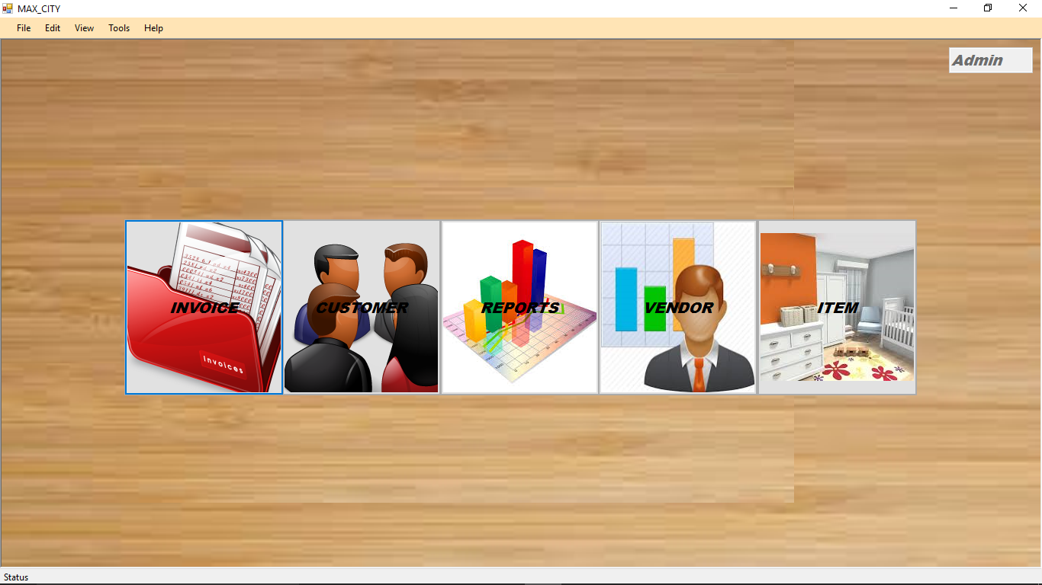
Demo

Slide 6
Question and Answers

Slide 7
Thank You

